Slide 1
Computer and Network Security Concepts
Course : DTSC6004001 – data security​
Session 1
Ade Putera Kemala
Effective Period : September 2023

Slide 2
Learning Outcomes
LO1: Explain the concepts of computer security and cryptography

Slide 3
OUTLINE
Computer Security Concepts
The OSI Security Architecture
Attack Surfaces and Attack Trees
A Model for Network Security
Standards

Slide 4
Computer Security Concept

Slide 5
Computer Security Concept
Cybersecurity Concept
Protection of information that is stored, transmitted, and processed in a networked system of computers, other digital devices, and network devices and transmission lines, including the Internet.
Notes:
Protection encompasses confidentiality, integrity, availability, authenticity, and accountability.
Methods of protection include organizational policies and procedures, as well as technical means such as encryption and secure communications protocols.

Slide 6
Computer Security Concept
Subset of Cybersecurity
Information security : This term refers to preservation of confidentiality, integrity, and availability of information. In addition, other properties, such as authenticity, accountability, nonrepudiation, and reliability can also be involved.
Network security : This term refers to protection of networks and their service from unauthorized modification, destruction, or disclosure, and provision of assurance that the network performs its critical functions correctly and there are no harmful side effects.

Slide 7
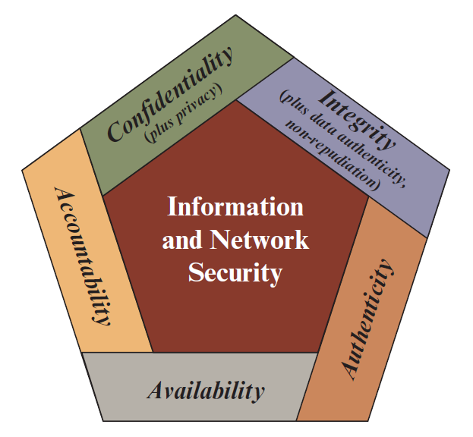
Computer Security Concept
Security Objective
Notes:
Confidentiality: This term covers two related concepts: Data confidentiality: Assures that private or confidential information is not made available or disclosed to unauthorized individuals. Privacy: Assures that individuals control or influence what information related to them may be collected and stored and by whom and to whom that information may be disclosed.
Integrity: Data integrity: Assures that data (both stored and in transmitted packets) and programs are changed only in a specified and authorized manner. This concept also encompasses data authenticity. System integrity: Assures that a system performs its intended function in an unimpaired manner, free from deliberate or inadvertent unauthorized manipulation of the system.
Availability: Assures that systems work promptly and service is not denied to authorized users.
Authenticity: The property of being genuine and being able to be verified and trusted; confidence in the validity of a transmission, a message, or message originator. This means verifying that users are who they say they are and that each input arriving at the system came from a trusted source.
Accountability: The security goal that generates the requirement for actions of an entity to be traced uniquely to that entity. This supports nonrepudiation, deterrence, fault isolation, intrusion detection and prevention, and after-action recovery and legal action.

Slide 8
The OSI Security Architecture

Slide 9
The OSI Security Architecture
OSI Security Architecture
Information security : This term refers to preservation of confidentiality, integrity, and availability of information. In addition, other properties, such as authenticity, accountability, nonrepudiation, and reliability can also be involved.
Network security : This term refers to protection of networks and their service from unauthorized modification, destruction, or disclosure, and provision of assurance that the network performs its critical functions correctly and there are no harmful side effects.
Notes:
The open systems interconnection (OSI) security architecture is useful to managers as a way of organizing the task of providing security. Furthermore, because this architecture was developed as an international standard, computer and communications vendors have developed security features for their products and services that relate to this structured definition of services and mechanisms.
the OSI security architecture provides a useful, if abstract, overview of many of the concepts that this book deals with. The OSI security architecture focuses on security attacks, mechanisms, and services.

Slide 10
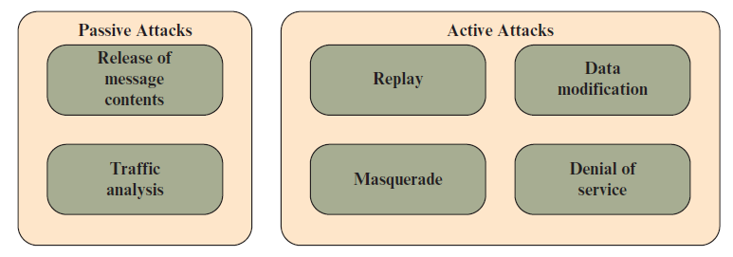
The OSI Security Architecture
SECURITY ATTACKS
Notes:
Passive Attacks
Passive attacks are in the nature of eavesdropping on, or monitoring of, transmissions. The goal of the attacker is to obtain information that is being transmitted. Two types of passive attacks are the release of message contents and traffic analysis. The release of message contents is easily understood. A telephone conversation, an electronic mail message, and a transferred file may contain sensitive or confidential information. We would like to prevent an opponent from learning the contents of these transmissions.
A second type of passive attack, traffic analysis, is subtler. Suppose that we had a way of masking the contents of messages or other information traffic so that opponents, even if they captured the message, could not extract the information from the message. The common technique for masking contents is encryption. If we had encryption protection in place, an opponent might still be able to observe the pattern of these messages.
Active attacks involve some modification of the data stream or the creation of a false stream and can be subdivided into four categories: replay, masquerade, modification of messages, and denial of service.
A masquerade takes place when one entity pretends to be a different entity.
Replay involves the passive capture of a data unit and its subsequent retransmission to produce an unauthorized effect.
The denial of service prevents or inhibits the normal use or management of communication facilities
Data modification may involve a man-in-the middle attack, in which the attacker selectively modifies communicated data between a client and server

Slide 11
The OSI Security Architecture
SECURITY ATTACKS
Notes:
Passive Attacks
Passive attacks are in the nature of eavesdropping on, or monitoring of, transmissions. The goal of the attacker is to obtain information that is being transmitted. Two types of passive attacks are the release of message contents and traffic analysis. The release of message contents is easily understood. A telephone conversation, an electronic mail message, and a transferred file may contain sensitive or confidential information. We would like to prevent an opponent from learning the contents of these transmissions.
A second type of passive attack, traffic analysis, is subtler. Suppose that we had a way of masking the contents of messages or other information traffic so that opponents, even if they captured the message, could not extract the information from the message. The common technique for masking contents is encryption. If we had encryption protection in place, an opponent might still be able to observe the pattern of these messages.
Active attacks involve some modification of the data stream or the creation of a false stream and can be subdivided into four categories: replay, masquerade, modification of messages, and denial of service.
A masquerade takes place when one entity pretends to be a different entity.
Replay involves the passive capture of a data unit and its subsequent retransmission to produce an unauthorized effect.
The denial of service prevents or inhibits the normal use or management of communication facilities
Data modification may involve a man-in-the middle attack, in which the attacker selectively modifies communicated data between a client and server

Slide 12
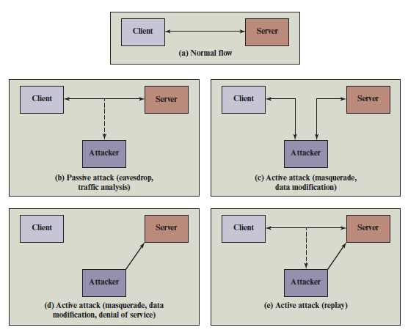
The OSI Security Architecture
SECURITY ATTACKS

Slide 13
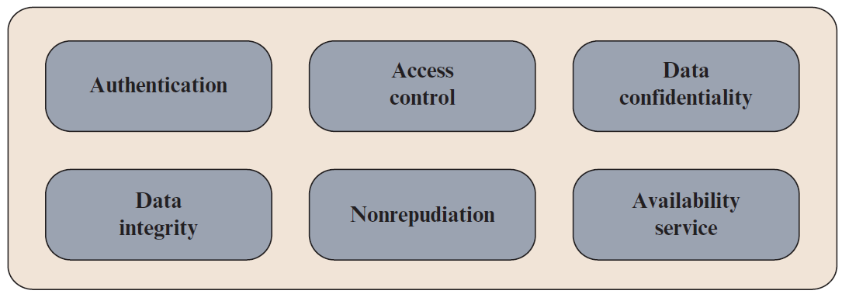
The OSI Security Architecture
SECURITY ATTACKS
Notes:
A security service is a capability that supports one or more of the security requirements (confidentiality, integrity, availability, authenticity, and accountability). Security services implement security policies and are implemented by security mechanisms.
The authentication service is concerned with assuring that a communication is authentic. In the case of a single message, such as a warning or alarm signal, the function of the authentication service is to assure the recipient that the message is from the source that it claims to be from.
Access Control
In the context of network security, access control is the ability to limit and control the access to host systems and applications via communications links.
Data Confidentiality
Confidentiality is the protection of transmitted data from passive attacks
Nonrepudiation
Nonrepudiation prevents either sender or receiver from denying a transmitted message. Thus, when a message is sent, the receiver can prove that the alleged sender in fact sent the message. Similarly, when a message is received, the sender can prove that the alleged receiver in fact received the message.
Availability Service
Availability is the property of a system, or a system resource being accessible and usable upon demand by an authorized system entity, according to performance specifications for the system (i.e., a system is available if it provides services according to the system design whenever users request them).

Slide 14
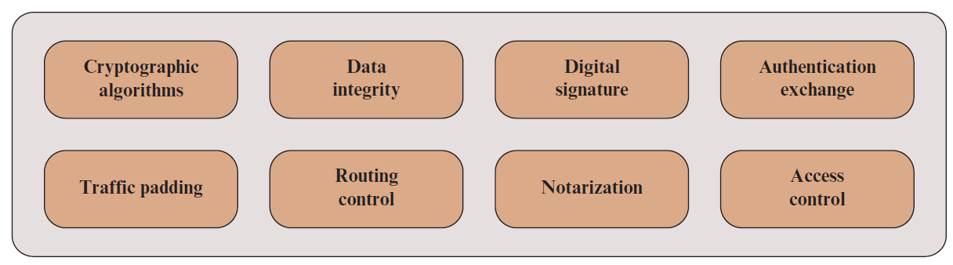
The OSI Security Architecture
SECURITY ATTACKS
Notes:
Cryptographic algorithms: A reversible cryptographic mechanism is simply an encryption algorithm that allows data to be encrypted and subsequently decrypted. Irreversible cryptographic mechanisms include hash algorithms and message authentication codes, which are used in digital signature and message authentication applications.
Data integrity: This category covers a variety of mechanisms used to assure the integrity of a data unit or stream of data units.
Digital signature: Data appended to, or a cryptographic transformation of, a data unit that allows a recipient of the data unit to prove the source and integrity of the data unit and protect against forgery.
Authentication exchange: A mechanism intended to ensure the identity of an entity by means of information exchange.
Traffic padding: The insertion of bits into gaps in a data stream to frustrate traffic analysis attempts.
Routing control: Enables selection of particular physically or logically secure routes for certain data and allows routing changes, especially when a breach of security is suspected.
Notarization: The use of a trusted third party to assure certain properties of a data exchange.
Access control: A variety of mechanisms that enforce access rights to resources.

Slide 15
Attack Surfaces and Attack Trees

Slide 16
Attack Surfaces and Attack Trees
Attack surfaces
Attack Surfaces : An attack surface consists of the reachable and exploitable vulnerabilities in a system, example:
Open ports on outward facing Web and other servers, and code listening on those ports
Services available on the inside of a firewall
Code that processes incoming data, email, XML, office documents, and industry-specific custom data exchange formats
Interfaces, SQL, and Web forms
An employee with access to sensitive information vulnerable to a social engineering attack

Slide 17
Attack Surfaces and Attack Trees
Attack surfaces
Attack surfaces can be categorized as follows:
Network attack surface: This category refers to vulnerabilities over an enterprise network, wide-area network, or the Internet.
Software attack surface: This refers to vulnerabilities in application, utility, or operating system code.
Human attack surface: This category refers to vulnerabilities created by personnel or outsiders, such as social engineering, human error, and trusted insiders.
Notes:
1. Included in this category are network protocol vulnerabilities, such as those used for a denial-of-service attack, disruption of communications links, and various forms of intruder attacks.
2. A particular focus in this category is Web server software.
An attack surface analysis is a useful technique for assessing the scale and
severity of threats to a system. A systematic analysis of points of vulnerability
makes developers and security analysts aware of where security mechanisms are
required. Once an attack surface is defined, designers may be able to find ways to
make the surface smaller, thus making the task of the adversary more difficult. The
attack surface also provides guidance on setting priorities for testing, strengthening
security measures, and modifying the service or application

Slide 18
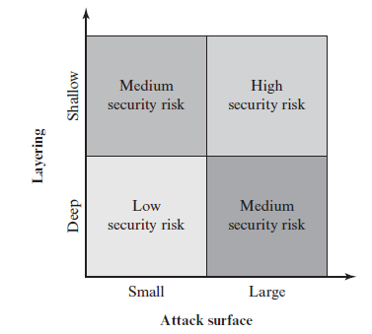
Attack Surfaces and Attack Trees
Attack surfaces

Slide 19
Attack Surfaces and Attack Trees
Attack trees
An attack tree is a branching, hierarchical data structure that represents a set of potential techniques for exploiting security vulnerabilities.
The security incident that is the goal of the attack is represented as the root node of the tree, and the ways that an attacker could reach that goal are iteratively and incrementally represented as branches and subnodes of the tree. Each subnode defines a subgoal, and each subgoal may have its own set of further subgoals, and so on. Each node other than a leaf is either an AND-node or an OR-node. To achieve the goal represented by an AND-node, the subgoals represented by all of that node’s subnodes must be achieved; and for an OR-node, at least one of the subgoals must be achieved.
Notes:
The final nodes on the paths outward from the root, that is, the leaf nodes, represent different ways to initiate an attack.
Branches can be labeled with values representing difficulty, cost, or other attack attributes, so that alternative attacks can be compared.
The motivation for the use of attack trees is to effectively exploit the information
available on attack patterns. Organizations such as CERT publish security
advisories that have enabled the development of a body of knowledge about both
general attack strategies and specific attack patterns. Security analysts can use the
attack tree to document security attacks in a structured form that reveals key vulnerabilities.
The attack tree can guide both the design of systems and applications,
and the choice and strength of countermeasures.

Slide 20
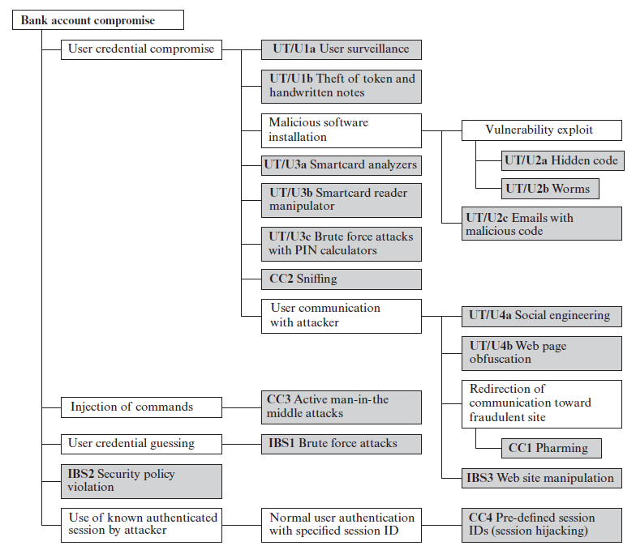
Attack Surfaces and Attack Trees
Attack trees for Internet Banking Authentication

Slide 21
Attack Surfaces and Attack Trees
Attack trees for Internet Banking Authentication
User terminal and user (UT/U): These attacks target the user equipment, including the tokens that may be involved, such as smartcards or other password generators, as well as the actions of the user.
Communications channel (CC): This type of attack focuses on communication links.
Internet banking server (IBS): These types of attacks are offline attacks against the servers that host the Internet banking application.

Slide 22
Attack Surfaces and Attack Trees
Attack trees for Internet Banking Authentication
User credential compromise: This strategy can be used against many elements of the attack surface. There are procedural attacks, such as monitoring a user’s action to observe a PIN or other credential, or theft of the user’s token or handwritten notes.
Injection of commands: In this type of attack, the attacker is able to intercept communication between the UT and the IBS.
User credential guessing: Brute force attacks against some banking authentication schemes are feasible by sending random usernames and passwords.
Security policy violation: Violating the bank’s security policy in combination with weak access control and logging mechanisms, an employee may cause an internal security incident and expose a customer’s account.
Use of known authenticated session: This type of attack persuades or forces the user to connect to the IBS with a preset session ID.
Notes:
An adversary may also compromise token information using a variety of token attack tools, such as hacking the smartcard or using a brute force approach to guess the PIN. Another possible strategy is to embed malicious software to compromise the user’s login and password. An adversary may also attempt to obtain credential information via the communication channel (sniffing).
Various schemes can be used to be able to impersonate the valid user and so gain access to the banking system.
The attack mechanism is based on distributed zombie personal computers, hosting automated programs for username- or password-based calculation.
5. Once the user authenticates to the server, the attacker may utilize the known session ID to send packets to the IBS, spoofing the user’s identity

Slide 23
A Model for Network Security

Slide 24
A Model for Network Security
Security aspects come into play when it is necessary or desirable to protect the information transmission from an opponent who may present a threat to confidentiality, authenticity, and so on. All the techniques for providing security have two components:
■ A security-related transformation on the information to be sent. Examples include the encryption of the message, which scrambles the message so that it is unreadable by the opponent, and the addition of a code based on the contents of the message, which can be used to verify the identity of the sender.
■ Some secret information shared by the two principals and, it is hoped, unknown to the opponent. An example is an encryption key used in conjunction with the transformation to scramble the message before transmission and unscramble it on reception.

Slide 25
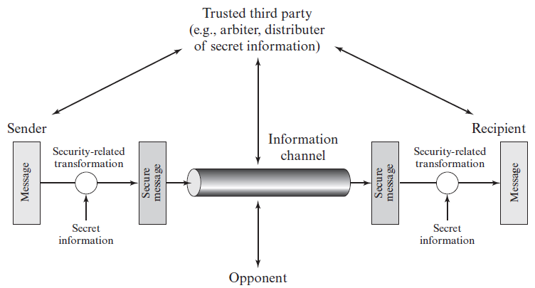
A Model for Network Security

Slide 26
A Model for Network Security
The general model shows that there are four basic tasks in designing a particular security service:
1. Design an algorithm for performing the security-related transformation. The algorithm should be such that an opponent cannot defeat its purpose.
2. Generate the secret information to be used with the algorithm.
3. Develop methods for the distribution and sharing of the secret information.
4. Specify a protocol to be used by the two principals that makes use of the security algorithm and the secret information to achieve a particular security service.

Slide 27
Standards

Slide 28
Standards
SECURITY STANDARDS
NIST : National Institute of Standards and Technology
ISOC : Internet Society
ITU-T : The International Telecommunication Union
ISO : The International Organization for Standardization
Notes:
National Institute of Standards and Technology: NIST is a U.S. federal agency
that deals with measurement science, standards, and technology related to
U.S. government use and to the promotion of U.S. private-sector innovation
Internet Society: ISOC is a professional membership society with worldwide
organizational and individual membership. It provides leadership in addressing
issues that confront the future of the Internet and is the organization home
for the groups responsible for Internet infrastructure standards, including the
Internet Engineering Task Force (IETF) and the Internet Architecture Board
(IAB).
ITU-T: The International Telecommunication Union (ITU) is an international
organization within the United Nations System in which governments and
the private sector coordinate global telecom networks and services
ISO: The International Organization for Standardization (ISO) is a worldwide
federation of national standards bodies from more than 140 countries, one from
each country. ISO is a nongovernmental organization that promotes the development
of standardization and related activities with a view to facilitating the
international exchange of goods and services and to developing cooperation in
the spheres of intellectual, scientific, technological, and economic activity.

Slide 29

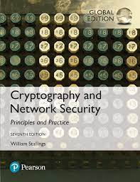
REFERENCES
These slides have been adapted from:
William Stallings, (2023). Cryptography and Network Security (8th ed.), Pearson, USA (chapter 1)
William Stallings, (2017). Cryptography and Network Security (7th ed.), Pearson, USA (chapter 1)
July 2023

